Slide 1
Cybersecurity and Online Safety for Regular People
“There is no security on this earth; there is only opportunity.”
– Douglas MacArthur
“Behold, I send you forth as sheep in the midst of wolves: be ye therefore wise as serpents, and harmless as doves.” (Matthew 10:16)
Get a notepad so you can take notes!
Notes:
I hope this presentation makes you wiser.
MacArthur said there is not security on this earth, but you can reduce the opportunities for people to harm you.

Slide 2
What are we talking about?
Secular and
Technical
concerns
Spiritual
concerns
Notes:
The arrow will move across the progress bar as I cover each topic.

Slide 3
What are we talking about?
General principles
Authentication
Passwords/passphrases
Multi-factor authentication
User sessions
Web site security and cookies
Hyperlinks
Social engineering, phishing, scams
E-mail attachments
Malware
Updates and antivirus software
Wi-Fi
Virtual private networks
The Internet of Things and “Smart” Homes
Cloud services
Data collection, aggregation and brokering
Pornography
Bullying
Unhealthy social arenas
Money sinks (and time wasters)
Misinformation
Notes:
The earlier topics are all secular or technical; again, I won’t try to educate you on all of the technical details.

Slide 4
Why are we talking about it? A comparison:
Driving | Using computers and the Internet
You probably don’t know much how an internal combustion engine works, but you know how to generally use a car | You probably have limited knowledge of how computers work inside and what you can use them for
You have some risk of physical danger | Dangers can include financial loss, long-term financial problems, addiction, depression, social damage, spiritual suffering, and death
You need a driver license, which requires education, training, and testing | No education or licensing is required
You probably already drive | You’re already in the middle of what we’ll discuss here
Notes:
I drive a car while only knowing a little about internal combustion engines.
I know a lot about how hardware, software, and networks operate.
Before you’re able to drive a car legally, you have to be educated, trained, tested, and licensed.
You started using the Internet without knowing what dangers exist in it.

Slide 5
My Background
Technical background:
  Bachelor’s deg., Computer Science, 2007; Master’s deg., Computer Science, 2019
  Certified Information Systems Security Professional (CISSP) since 2014
  Army network systems engineer since 2014
  Taught intro. comp. courses at the United States Military Academy (USMA) for 4 yrs
  Directed/taught USMA courses about network services, interface design for 3 yrs
  Currently at the Regional Cyber Center for the Continental U.S. (RCC-CONUS)
Spiritual background:
  Member of the Church of Jesus Christ since childhood
  Served in various callings; recently a member of the Newburgh Stake high council
  I strive to uphold my covenants and seek continual personal revelation from God

Slide 6


Too Much Information!
I will have to speak quickly in the early topics
I will skip technical details but give advice
You will miss some ideas, but you’ll still learn
Jot down notes for further study later
I will slow down for the more spiritual topics
E-mail questions to
I will post these slides and responses to questions at jbfisher.net
Don’t expect my web site to be fancy ☺
Notes:
Some of you may know a fair amount about these topics, I hope it’s still helpful for you.
Others may feel like it’s too much to absorb, like drinking from a firehose.
I will also skip some topics if needed; you can check them out later if you’re interested.
These slides are available at my web site, and I will post answers later to questions that you send me via e-mail.

Slide 7
Skepticism is Warranted!!!
From Elder Dallin H. Oaks, Truth and the Plan, October 2018:
“We live in a time of greatly expanded and disseminated information. But not all of this information is true. We need to be cautious as we seek truth and choose sources for that search. …
We should also be cautious about the motivation of the one who provides information. … If the source is anonymous or unknown, the information may also be suspect.
Our personal decisions should be based on information from sources that are qualified on the subject and free from selfish motivations.”
Some would consider this a component of “critical thinking”.
Notes:
We have a natural inclination to trust people and technology, but it is not always warranted.
In addition to there bring a lot of misleading information in the world, there are a lot of people who will try to harm us, usually for their financial gain.

Slide 8
Basic Terms (with more to follow as we go)
Computer network: Two or more computers that are connected and send information to each other
The Internet (with a capital I): The vast and growing network of networks that spans the globe and includes many types of devices and technologies
The World Wide Web: The part of the Internet designed to be displayed and viewed via web browser
Web browser: Type of software (a program/application/“app”) designed to display web content such as sites/pages
Server: A computer that does something (provides a service) for people
Client: A person, computer, or application that uses a service
Encryption: Changing information to make it temporarily unreadable

Slide 9

The Perennial Security Conflict
SECURITY
USABILITY / ACCESSIBILITY / CONVENIENCE
Notes:
We want everything to be easy, but as we make it easier for us to do things online, we make it easier for other people to do those same things.
Free clipart image from https://lh3.googleusercontent.com/proxy/uEwsy5wwCxQhQhZUNs93mGmxSdpC4GEdCluVfnz4sV1M6Tpc_qBLzaBWanrueR78Tv-P2zM-YDGkOFJv07OgERk2FXQDA99lKg

Slide 10
Authentication
Authentication refers to the act of proving identity
  You prove your identity to access your information online
  Web sites prove to you that they’re authentic
Authenticating ourselves typically happens via three ways:
  What we know (user name and passphrase, PIN)
  What we have (physical objects)
  What we are (biometrics like fingerprints, retinal scans)
  Also possibly where we are or what we do
“Credentials” are what we use to authenticate ourselves—commonly a user name and passphrase
Notes:
Part of being able to trust someone or something is being sure of their identity.

Slide 11
Authentication: Passwords and Passphrases
The most common user authentication method is from the “something we know” category—passwords—because they’re the easiest to implement
Passwords are highly problematic because good passwords are often difficult to remember
What makes a good password?
  Easy for people to remember
  Difficult for other people or computers to guess
Two ways of making passwords harder to guess; which is most important?
  Add complexity
  Add length
“Passphrase” vs “password”—can be more than one “word”
Notes:
The terms “password” and “passphrase” are roughly equivalent, but I will often use the term “passphrase” because it suggests greater length than a single word.

Slide 12
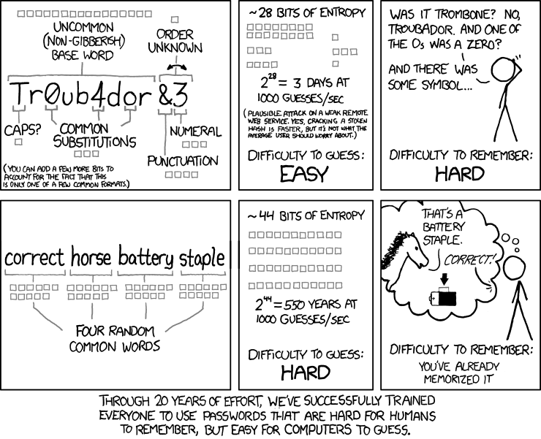
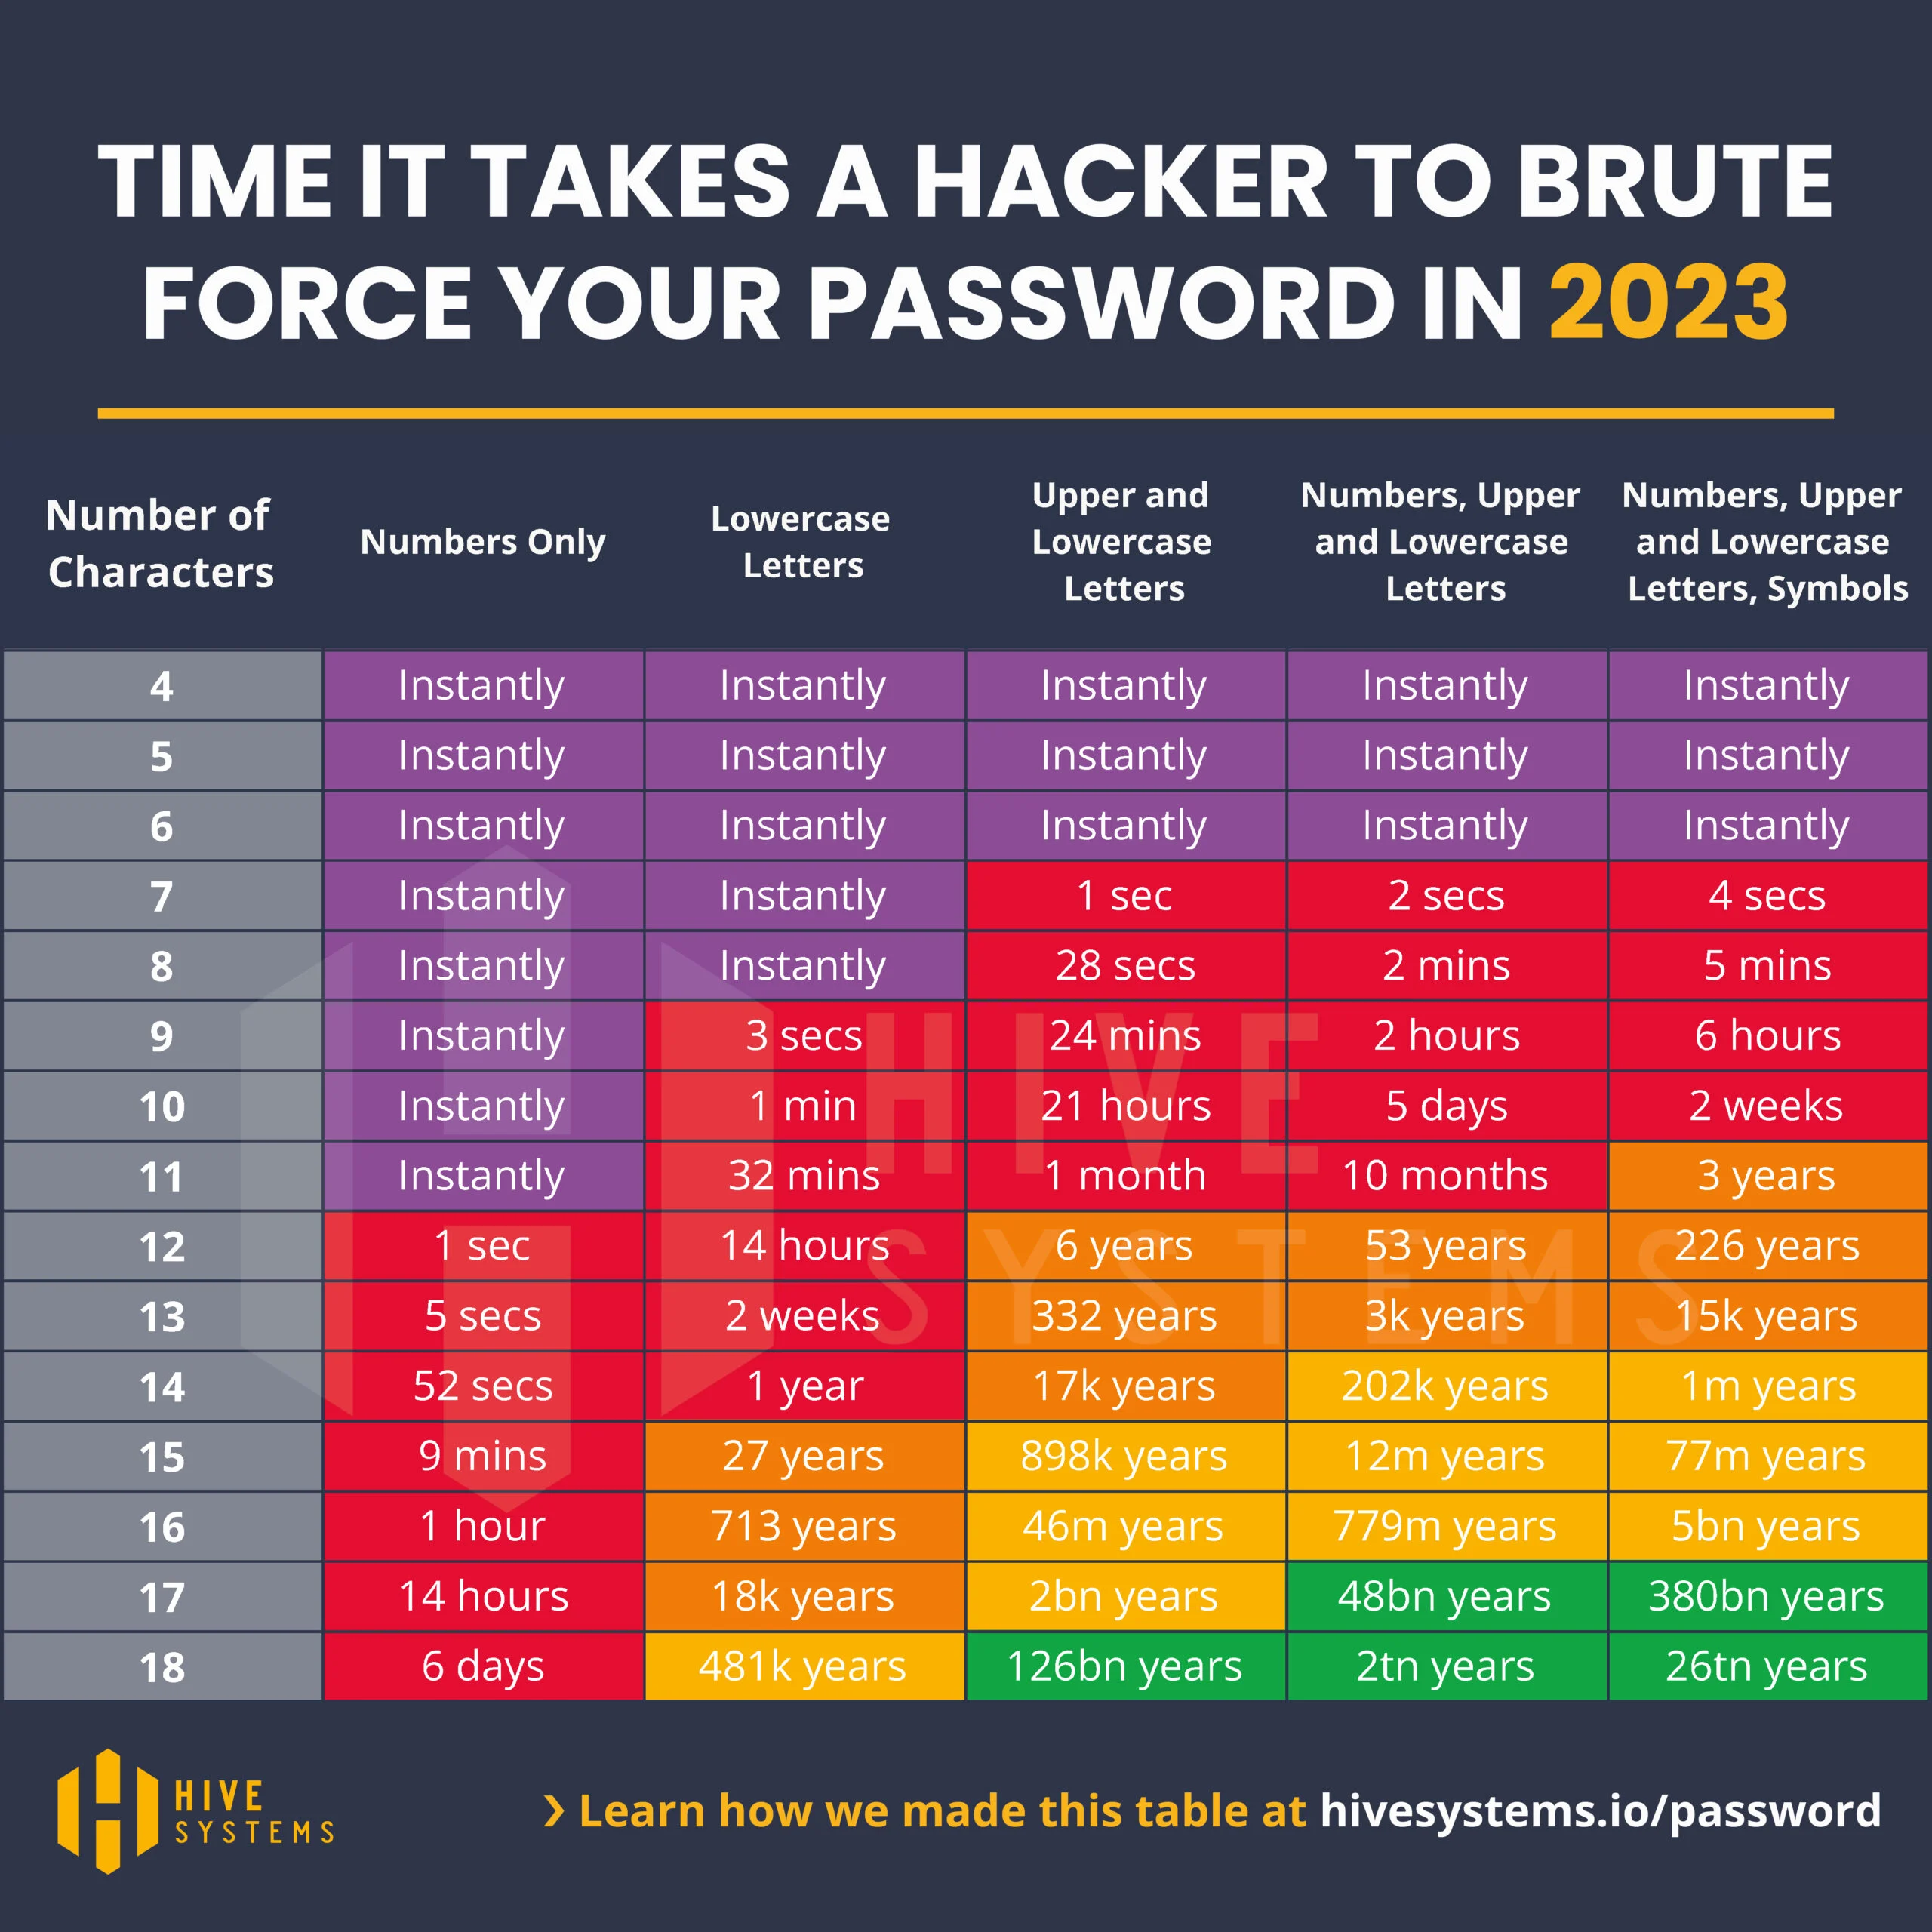
Passphrase Length and Complexity
Notes:
This comic strip, which is already several years old, highlights the problem with passwords and suggests that length is more helpful than complexity.
The chart on the right shows that both length and complexity increase the time it takes for a hacker to use a brute force attack to discover a passphrase.
Moderately complex passphrases with at least 12 characters or mildly complex passphrases with at least 16 characters are good.

Slide 13
Passphrase Advice
Longer is more secure
  Some systems have a maximum length ☹
Never reuse important passphrases
Which of your passphrases is most important?
  Bank is a good answer, but not the most important
  Your e-mail provides access to everything via “password recovery”
What passphrases don’t need to be remembered?
  If you rarely use it and can use the “I forgot my password” option
Password managers/web browsers can be useful
Multi-factor authentication provides another layer of security
Notes:
MFA is discussed on the next slide.

Slide 14
Multi-Factor Authentication (MFA)
Simple versions are often called “two-factor authentication”
A layperson’s idea of MFA is not relying only on “something we know”, but adding other factors (such as something we have or are)
This is commonly accomplished via text messages to phones; this method is secure enough for some purposes (not government)
“Security” questions and social engineering
  “Security” questions are not true MFA, but they’re an improvement when used in conjunction with other methods
  They’re the opposite of secure when used as an alternative access method
  Suggestion: Use fictional answers that only you will ever know
Notes:
Social engineering will be discussed more in a few slides.
One Hollywood example of “security” questions being a problem is shown in the 2013 film Now You See Me.

Slide 15
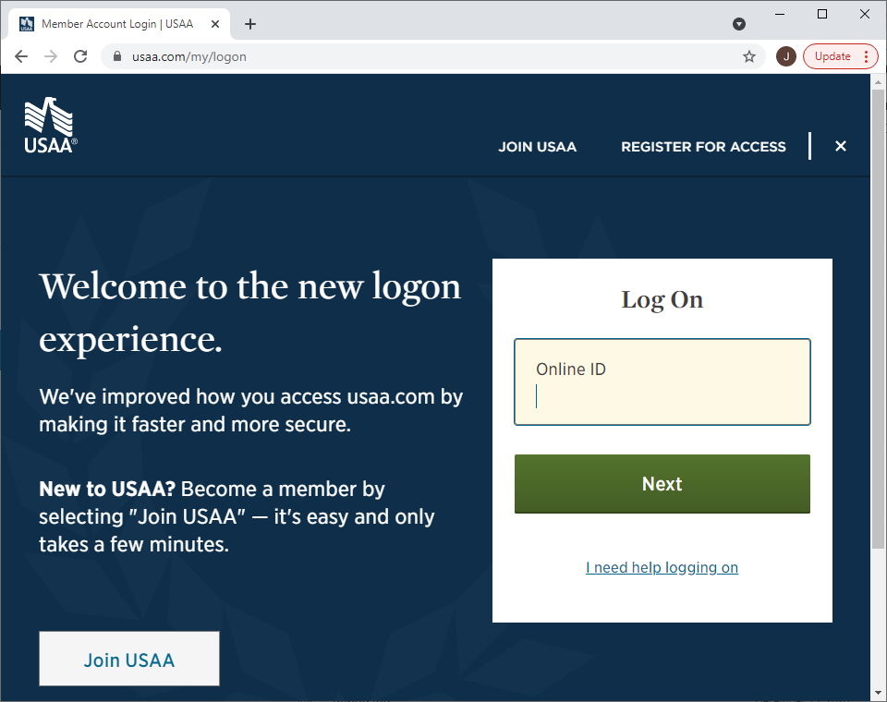
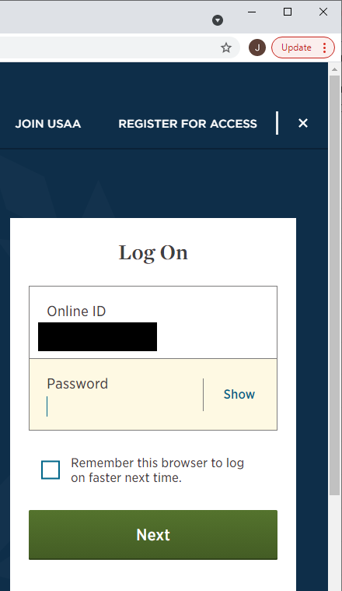
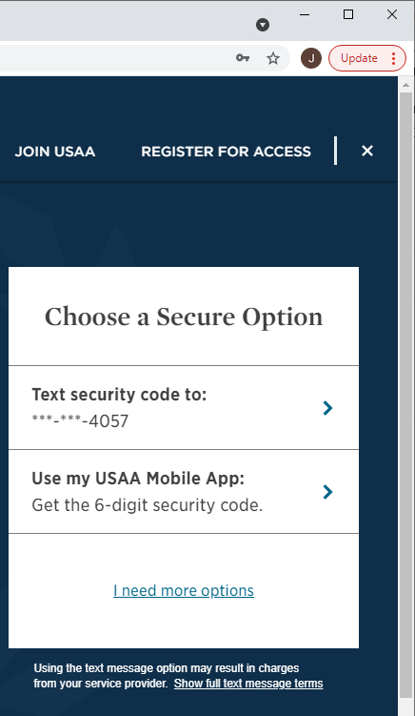
Secure Multi-Factor Authentication Example
The user name is obscured for this example.
Text message: “USAA FRAUD PREVENTION ALERT: USAA will never contact you for this code, don’t share it: XXXXXX.”

Slide 16
User Sessions
Session timeouts—how long do you stay logged in?
Concurrent logins—can you log in to multiple devices simultaneously?
Login notifications—are you notified when your credentials are used?
“Leaving the door open” is not “account hacking”; it’s carelessness
Federated login services—logging in using Google, Microsoft, etc.
Don’t enter credentials for one site in another site; don’t let anyone else have your credentials

Slide 17


Person-to-Person Authentication
Many social media accounts are fake
Be wary of anyone you meet online
Be wary of duplicate social media accounts
Report suspected fake accounts
When you associate yourself with another account, you are endorsing it to others; people see your “friends” and feel they are legitimate accounts
This is “Vanessa”.
Don’t be his online friend.
Will you accept
a friend request
from Vanessa?
Notes:
Sometimes people make legitimate second accounts because they forgot their passwords. ☹

Slide 18

Web Site Security: Functional vs. Secure
Functional technology vs. secure technology
  People started by making networks that worked
  Later, it became clear that people were doing bad things, and networks needed to also be secure
HTTP vs. HTTPS
  HTTP: web traffic that works, but is in unencrypted “plain text”
  HTTPS: web traffic that is encrypted for added security; often represented by padlock icons next to web addresses
HTTPS doesn’t solve all of our problems, but make sure you don’t send important information (such as credit card numbers) via HTTP

Slide 19
Web Site Security: Certificates
Identify a web site so it can prove its identity to you
Issued by and “signed” by certification authorities (CAs)
  Computers know these CAs when we buy them
Contain information about the requesting company
Have a date associated and eventually “expire”
Are handled somewhat differently by different web browsers
Why do we sometimes encounter invalid certificates?
  The organization might not have paid for a current certificate (like mine)
  The site might be fake, potentially designed to trick you
Notes:
When you’re presented with a certificate error, verify the web address.
Consider whether or not you need to use it.

Slide 20
Cookies
Small pieces of information exchanged between a client and server, and stored by a client web browser
Used for:
  Session management
  Personalization
  Tracking
Can be temporary (session) or persistent; you can clear them
Useful and generally safer when generated by reputable sites you choose to visit
Can be created by a “third party” from things like advertisements and used to track information about you
Sometimes you choose which cookies to allow for a given site; some are required
Is some tracking for personalized ads a good and helpful thing?

Slide 21
URLs and Hyperlinks
Links allow easy navigation with one click
Uniform Resource Locator (URL) contains protocol, host name, file path, and optional information
  https://www.churchofjesuschrist.org/study/scriptures?lang=eng
Host names are hierarchical (www.cs.colorado.edu)
Most important parts toward the right
  “cloudflare.com” vs. “cloud.flare.com”
Links can be text, an image, or a button
On-screen text and real URL can be different
Hover mouse over link without clicking to see the real URL
When in doubt, don’t click; type known addresses or use bookmarks
Notes:
Some web addresses are set up specifically to catch people who spell the real ones wrong.

Slide 22
Quick Breather
Are you feeling like this yet?
Remember that you can send me questions later.

Slide 23
Social Engineering
Social engineering is the practice of manipulating people into divulging information or otherwise act against their best interest
Can take advantage of people’s natural desire to help others
Can involve impersonation and/or “verifying” information
Principles that can be at play:
  Authority
  Intimidation
  Consensus
  Scarcity
  Urgency
  Familiarity
May make reference to information about you; easier if you give lots of information about yourself publicly (e.g., social media)
Notes:
When nothing else works, social engineering always works.
Sometimes, instead of worrying so much about how technology works, hackers will focus on how people work.
Sometimes we assume that if someone is asking about it or trying to access it, they’re supposed to.
Perhaps they’re wearing overalls, claiming to be maintenance personnel so they can get to a server room.
People can reportedly get into all sorts of places, like concerts, merely by carrying a ladder.
The recorded sound of a crying baby can make a phone operator more likely to help a supposed mother.
If someone on the phone knows your name and address (or other information), does it give them legitimacy?

Slide 24
Scams
Be wary of anyone you don’t know, especially if they have contacted you
Do not provide or “verify” your personal or computer information
Do not succumb to pressure from urgency or influence from romance
Do not allow others to have remote access of your computer
  Unless they’re IT personnel from your work that you have verified; then, close personal information first and watch what they do while they’re connected
Do not succumb to pressure to use alternative and untraceable payments (such as gift cards or wire transfer)
Do not keep concerns secret; consult someone smart that you trust
Don’t tolerate abuse
If it sounds too good to be true, it probably is; if it sounds bad, it still might not be true
Notes:
Realistic scenario; a scammer tricks and older person into thinking she has made a mistake and needs to return money; they is embarrassed and doesn’t want to tell their spouse, but the spouse eventually finds out when several thousand dollars are gone for good.

Slide 25
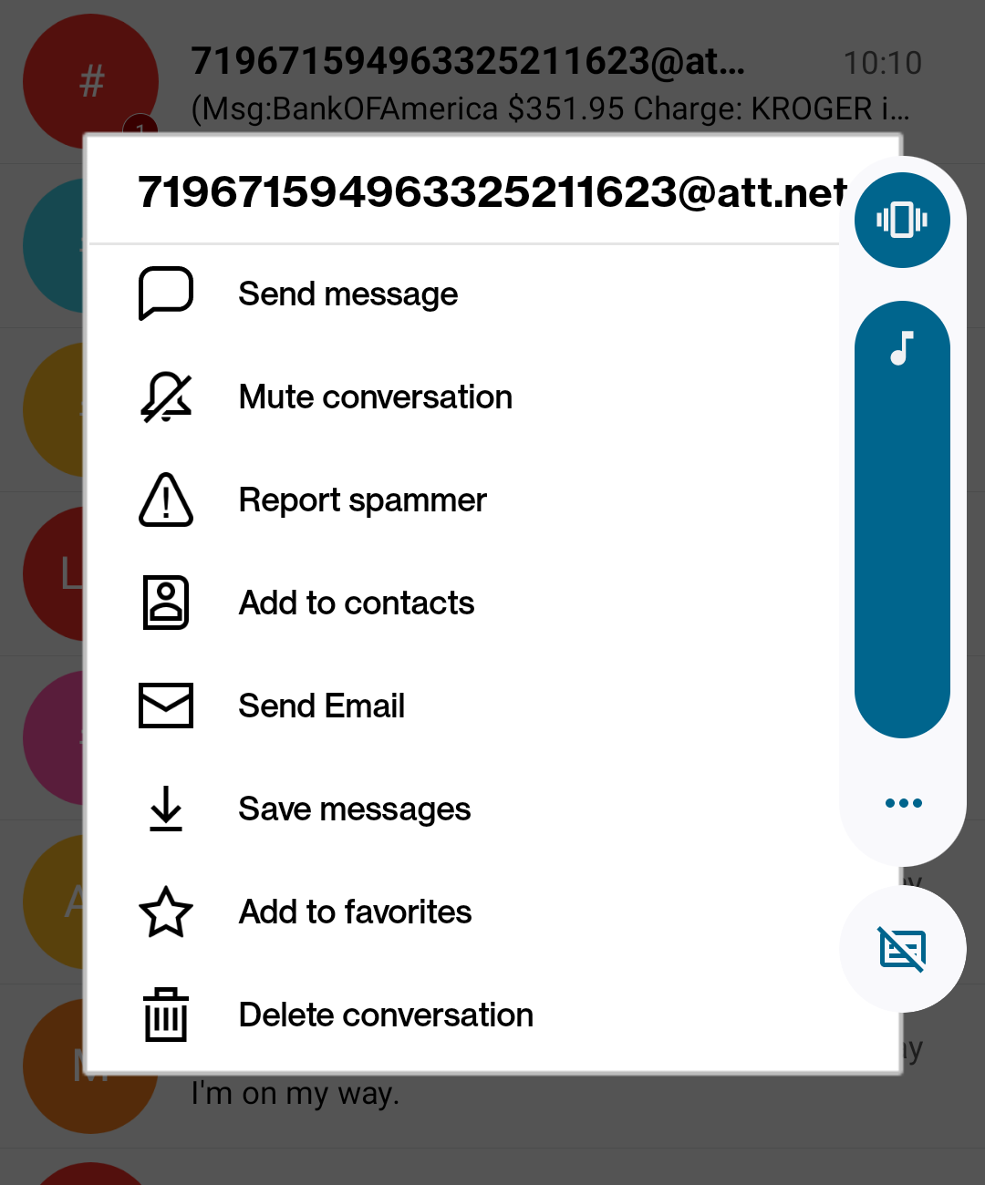
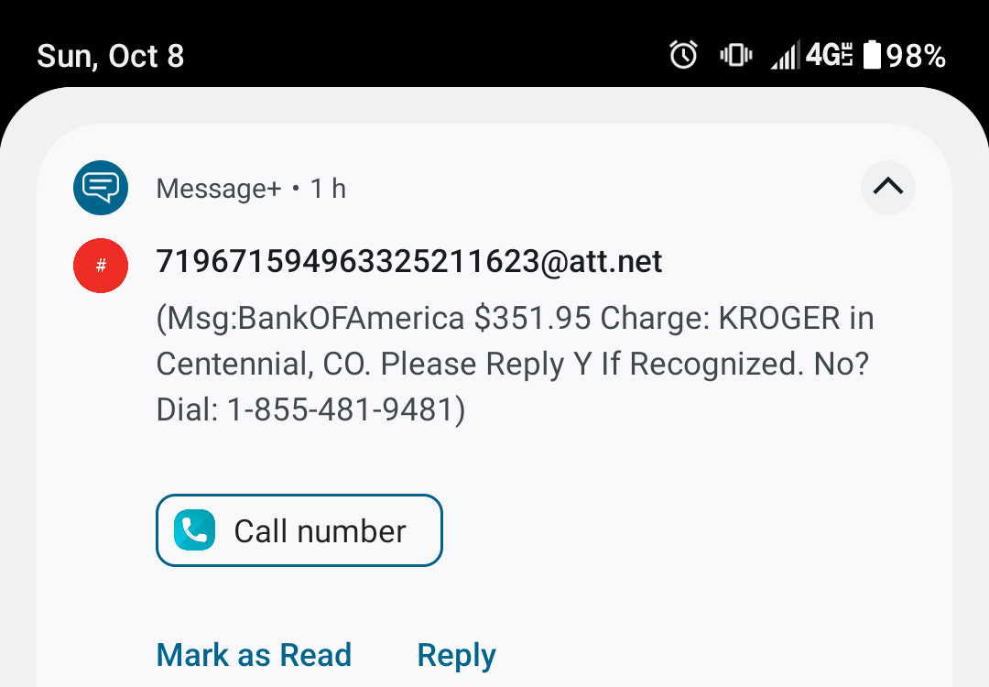
Example Via Text Messaging (phone screenshots)
I don’t have a card with Bank of America
Notes:
False e-mail and text messaged can often be reported.

Slide 26
Phishing
What is phishing?
  A form of social engineering
  Fraudulent e-mail that purports to be from legitimate sources—either organizations and businesses, or people that you know
  Attempts to get you to reveal information, such as credit card numbers
  May redirect you to fake web sites via bad links
E-mail is very easy to fake; the name on the “envelope” doesn’t have to match the actual sender’s e-mail address
Large batches of e-mails are very easy for computers to send
You can report phishing attempts within your e-mail service
Don’t open suspicious e-mails; don’t click on links in e-mail
Notes:
I’ve seen a number of fake e-mails that seemed to be from a friend who was telling me that they forgot to send me some pictures, and had a supposed link to them.

Slide 27
E-mail Attachments
PDFs, spreadsheets, and other common file types can include program code, and thus can contain malware
Files can have a hidden file extension
  In one actual scenario that caught a number of people, “AnnaKournikova.jpg.vbs” was displayed on screen as “AnnaKournikova.jpg”, and VBS files contain code—not a picture
Don’t open attachments unless:
  You’re expecting something because the sender told you elsewhere,
  It’s necessary or important, and
  You trust the sender a lot (both their character and their technical knowledge)

Slide 28
Malware: “mal” (bad) + “software”
Some types include:
  Virus – harmful software that replicates itself
  Trojan horse – malware disguised as legitimate software
  Worm – malware that replicates itself without human intervention
  Adware – displays ads to generate revenue elsewhere
  Spyware – steals information from your computer’s screen and/or keyboard
  Ransomware – encrypts data on your computer until you pay money
Applications from official app stores can contain malware; the stores cannot practically check the sheer amount of software they offer
Back up important files somewhere else (e.g. external drive, cloud)

Slide 29
Updates and Antivirus Software
As a rule, software is complex and has vulnerabilities to cyber attacks
When these vulnerabilities are found, those attacks are referred to as “zero-day exploits”
Programmers will write software “patches” to correct the problem
Your application will be vulnerable until you patch/update it
Many automated attacks target old vulnerabilities; those who update their systems are fine, but the attacks still succeed where patches have not been applied
Antivirus software is useful for stopping a lot of malware; use it
Notes:
As a rule, all software has bugs and vulnerabilities.

Slide 30
Wi-Fi
Wi-Fi is the common technology for wirelessly connecting devices
  Different from other wireless technologies such as cellular and Bluetooth
Whereas a direct connection is required for eavesdropping on wired networks, wireless communication broadcasts in the open
Avoid using free public wi-fi; be cautious when you do
Beware of wi-fi signals (“SSIDs”) with tricky names; be sure you’re connecting to the correct access point
Don’t leave your home wi-fi signal(s) unsecured

Slide 31
What are Virtual Private Networks (VPNs)?
The
Internet
The
Internet
ENCRYPTION
VPN server
Your device
Your device
A private network
Normal Internet usage
Using a VPN

Slide 32
Virtual Private Networks (VPNs)
A VPN provides:
  Access to information and services on a private network
  Access to services for a geographic area (video streaming)
  Some security from masking your location and providing encryption; this is particularly useful when using free public WiFi
VPNs also involve:
  Delay—light and electricity do take time to cross long distances
  Extending trust to the VPN provider who sees all of your Internet traffic (at least the destination—what web sites you are using)
  Fees, if provided commercially
Make conscious decisions about when to use VPNs

Slide 33
The Internet of Things and “Smart” Homes
Internet of Things (IoT): Billions of devices connected to the Internet
“Smart” homes have multiple connected devices
  Thermostat, refrigerator, televisions, light bulbs, cameras, door locks, garage door opener, etc.
How are these devices secured?
Often have default user names and passwords
“Botnets” can include IoT devices and can be used for Distributed Denial of Service (DDoS) attacks, which means flooding a server with so much information that it can’t respond to legitimate clients
If you do use “smart” devices in your home, don’t leave them unsecured
Notes:
If you can do something, then so can other people.
If someone can remotely see information about my lights, thermostat, and refrigerator, they may be able to tell when I’ve been away from home for an extended period of time. Can they remotely unlock my doors or garage?

Slide 34
Cloud Services
Sometimes when we use computers and mobile phones, the software, information, and processing power comes from our device
Sometimes, it comes from computers far away from us—these computers provide “cloud” services
Major cloud service providers for regular computer users include Microsoft Office 365 and Google (Drive, etc.); there are many others
Major providers typically have good security, but remember that you are extending trust to them
You may also be giving up some rights to your data; you probably use these services, but have you read all of the Terms and Conditions of service?
Make conscious decisions about what information you put online

Slide 35
Data Stored by Desired Services
It’s fair to question how free services survive as businesses; when the service is free to you, you are the product
Legitimate service providers keep a lot of information about you that you have willingly shared; you have agreed to this
Examples of common companies that keep your data include Google, Apple, Facebook, Twitter, Snapchat, Instagram, LinkedIn, Spotify, Tinder, Experian, and many more
Notes:
When Mark Zuckerberg was asked by Congress how Facebook makes money, he answered that it is through advertising; this is true, but part of their business model includes knowing a lot about you.

Slide 36
Data Stored by Desired Services
If you’re curious about what they have on you, you can request a copy of your personal information (at least some of it)
You will be surprised at what is there
To find out how to do this, search online for something like “how to download personal data ______” with whatever service you use
If given the option to download HTML or JSON data, choose HTML
If you end up with JSON files somehow, they can be viewed with the Firefox browser
Notes:
When Mark Zuckerberg was asked by Congress how Facebook makes money, he answered that it is through advertising; this is true, but part of their business model includes knowing a lot about you.

Slide 37
Data Aggregation and Brokering
Data brokers (such as Axciom and Intellius) are companies that exist to gather information by observing your habits online, and then sell the information (often to advertisers)
You never asked to use a service provided by them, but they gather your data anyway
Worried about data brokers?
  You can temporarily opt out of each data broker’s processes
  You can also pay for services that manage this for you
Notes:
You can audit your personal digital footprint by downloading a copy of your personal data from services you use and investigating what data brokers have gathered.

Slide 38
Pause
Has any of this made you worried?
Don’t be intimidated; you won’t know technical details, but you can avoid being an easy target by following the basic advice I’ve given
Remember that I can answer questions later and post answers for you

Slide 39
Old Problems, Easier Access
There are many serious dangers which are now able to reach us more easily because of the Internet
Many of these dangers are addictive; addiction changes the chemistry of our brains and removes our ability to make good choices
Many of these dangers are marked by a seeming shortcut or alternative to the good things God has provided for us
When we know we’re doing something wrong, we tend to want to do it in secrecy—using the Internet alone, or with screens that are not visible to others; avoiding those situations can ward off problems
Impaired judgment comes from BLAST—when we are Bored, Lonely, Angry, Scared/Sad/Stressed out, or Tired—so we should be more cautious then
Notes:
When we know that a bad situation is impacting us, we need to change it. Find something productive to do. Get support from others. Don’t stay up late.
This applies to most of what we’ll discuss next.

Slide 40
Pornography
Pornography is image, video, audio, and written information that inappropriately induces sexual feelings
It is readily available in many forms online and intrudes on us
Pornography skews our vision of the world and distances us from the Spirit of God
Pornography is addictive (literally changes the brain) and can lead to people losing their jobs and families
No one is immune to it
Some is bad, some is really bad, and some is extremely horribly bad
Parents need to teach their children about its dangers
You can use the Church of Jesus Christ’s “Addressing Pornography” web site for assistance:
  www.churchofjesuschrist.org/study/life-help/pornography
Notes:
From friend of mine who is a technological forensics expert and a former bishop:
Every criminal activity is driven by selfishness and a degradation of morality.
Forensics examiners overwhelmingly find morally degrading materials in conjunction with other crimes--particularly pornography.
Pornography is a gateway; no one wakes up and decides to commit a great moral wrong; they start with lesser evils.

Slide 41
Words of the Prophets
“…whosoever looketh on a woman to lust after her hath committed adultery with her already in his heart.” (Matthew 5:28)
“…to be carnally minded is death”. (Romans 8:6)
“Why is lust such a deadly sin? … it defiles the highest and holiest relationship God gives us in mortality … Someone said once that true love must include the idea of permanence. True love endures. But lust changes as quickly as it can turn a pornographic page or glance at yet another potential object for gratification walking by, male or female. … Along with filters on computers and a lock on affections, remember that the only real control in life is self-control. Exercise more control over even the marginal moments that confront you.” (Elder Jeffrey R. Holland, Quorum of the Twelve Apostles, Place No More for the Enemy of My Soul, April 2010)
Notes:
I’ve included some words of prophets, living or ancient, that deal with these subjects, but of course I only have a small selection.
Elder Holland has also mentioned that “immoral activity is not just a man’s problem”. (April 2010)
It’s easy to believe the lie that pornography only hurts one person, and it’s easy to justify it as being a lesser sin, but scripture tells us how serious it is.

Slide 42
Bullying
Bullying has been around for a long time, but the Internet provides more avenues for it and allows it to happen with limited visibility
In the severest cases, it can lead to suicide
No one should face problems alone
Parents should inquire with their children about their social interactions and about the way that people are interacting with them online, to identify problems before they grow
Again, the Church has resources online to address bullying; do a quick search on the Church’s web site and see what you can find
Notes:
One of the worst aspects of bullying is that victims will tend to keep the trouble to themselves.

Slide 43
Words of the Prophets
“And whoso shall receive one such little child in my name receiveth me. But whoso shall offend one of these little ones which believe in me, it were better for him that a millstone were hanged about his neck, and that he were drowned in the depth of the sea.” (Matthew 18:5-6)
“There is no place for this in your cyberspace, neighborhoods, schools, quorums, or classes. Please do all you can to make these places kinder and safer. If you passively observe or participate in any of this, I know of no better advice than that previously given by Elder Dieter F. Uchtdorf: ‘When it comes to hating, gossiping, ignoring, ridiculing, holding grudges, or wanting to cause harm, please apply the following: Stop it!’” (Elder Gary E. Stevenson, Quorum of the Twelve Apostles, Hearts Knit Together, April 2021)
Notes:
Bullying doesn’t only happen among children, but I want to emphasize again that parents should talk to children about what they experience.

Slide 44
Unhealthy Social Arenas
The Internet has changed sociality
Example: teenagers are no longer overwhelmingly eager to drive cars
Social media presents an incomplete picture of the world; we’re often tempted to compare our weaknesses or troubles with others’ success
Studies have shown links between social media usage and depression
Social media can be addictive
Consider not using some social media, or taking a break from it
Dangerous people sometimes pose as children; talk to your children about who they interact with online
Notes:
Remember that people have lived for 6,000 years of human history without these things, and we can too, if needed.

Slide 45
Words of the Prophets
“… Choose you this day whom ye will serve”. (Joshua 24:15)
"Viewing social media through the lens of the gospel can prevent it from becoming a spiritual eclipse in our lives. ... If you discover anything that seems to be blocking the light and joy of the gospel in your life, I invite you to place it in a gospel perspective. Look through a gospel lens and be vigilant not to allow insignificant and inconsequential matters in life to obscure your eternal view of the great plan of happiness. In short, don’t let life’s distractions eclipse heaven’s light." (Elder Gary E. Stevenson, Quorum of the Twelve Apostles, Spiritual Eclipse, October 2017)

Slide 46
Money Sinks (and Time Wasters)
Gambling is deceptive, addictive, and potentially catastrophic
Computer games are often free-to-play (requiring no real money), but have many options for in-game bonuses that do cost real money
Unobserved children have sometimes spent thousands of dollars of their parents’ money for completely frivolous game items
Choose in advance how much money you are willing to spend—if any
Learn how to restrict real-money purchases in any application you use
Beware of the amount of time you and your children spend on activities that occupy you without providing anything in return

Slide 47
Words of the Prophets
“From the beginning we have been advised against gambling of every sort. The deterioration and damage comes to the person, whether he wins or loses, to get something for nothing, something without effort, something without paying the full price.” (President Spencer W. Kimball, President of the Church of Jesus Christ of Latter-day Saints, “Why Call Ye Me Lord, Lord, and Do Not the Things Which I Say?”, April 1975)
“One of our young men recently said, ‘Pay five bucks to see a movie; pay five bucks to play poker—it is the same idea.’ It is not the same idea. In one case you get something for which you pay; in the other case, only one picks up the winnings and the others are left empty-handed.” (President Gordon B. Hinckley, President of the Church of Jesus Christ of Latter-day Saints, Gambling, April 2005)
“Wherefore, do not spend money for that which is of no worth, nor your labor for that which cannot satisfy.” (2 Nephi 9:51)

Slide 48
Misinformation
False information isn’t new, but it’s more easily spread than ever and it often looks legitimate
It frequently comes to us in such important areas as government/politics, medicine, and interpersonal matters
People often spend time in “echo chambers” that only serve to reinforce the ideas they already hold, without critical thinking
Beware of what is flattering and divisive
Notes:
People are continually led to believe things that are partially or totally false.
Are we thinking critically? How do we consider positions or arguments that go against what we already believe? Changing our ideas can be either good or bad.
In social media, we will often find people supporting us even when we’re going down a bad path.

Slide 49
Misinformation
The most harmful misinformation is that which attacks our faith
God does expect us to use our intellect, and simultaneously, “without faith it is impossible to please him”.
You can always seek and receive a reassurance from God about fundamental truths
When something undermines what God has revealed to you, don’t trust the quotations to be accurate or interpretations to be correct
  Other people’s “research” is sometimes shallow
  Quotations can be misleading if incomplete or when lacking adequate context
  Historical artifacts do not always agree
Notes:
The Church of Jesus Christ provides an enormous amount of information online.
I have explored many, many claims which, if I accepted them on their surface, might cause me to doubt my faith. They are often made by people who, themselves, once had faith but let go of it. As I have really looked into them, I have repeatedly found the claims to be incorrect or insubstantial.

Slide 50
Words of the Prophets
“The voices and pressures of the world are engaging and numerous. But too many voices are deceptive, seductive, and can pull us off the covenant path. To avoid the inevitable heartbreak that follows, I plead with you today to counter the lure of the world by making time for the Lord in your life—each and every day. If most of the information you get comes from social or other media, your ability to hear the whisperings of the Spirit will be diminished. If you are not also seeking the Lord through daily prayer and gospel study, you leave yourself vulnerable to philosophies that may be intriguing but are not true. Even Saints who are otherwise faithful can be derailed by the steady beat of Babylon’s band.” (President Russell M. Nelson, President of The Church of Jesus Christ of Latter-day Saints, Make Time for the Lord, October 2021)
Notes:
If we’re seeking the guidance of the Holy Ghost, as President Nelson has so often encouraged us to do, we will have much greater ability to discern truth and falsehood.

Slide 51
Faith in Jesus Christ and the guidance of the Holy Ghost should guide your usage of technology, and technology should strengthen both.
God wants us to be eternally happy. Remember that “men are, that they might have joy.” (2 Nephi 2:25) If something in your life—habits, hobbies, computer/mobile applications, social media—doesn’t contribute to that, why keep it?
Repentance means positive change—ridding ourselves of the burdens that come from sin. It’s not something to avoid; it’s what we have covenanted to do, and God will bless us as much as we let Him.
Heavenly Father didn’t intend for us to face life alone. The grace of Jesus Christ will strength us, Church leaders receive revelation for us, and as disciples of Christ, we have covenanted “to bear one another’s burdens, that they may be light”. (Mosiah 18:8)

Slide 52
Want More Answers?
In addition to researching these topics online, you can send me questions via e-mail at
I will post responses to your questions and post these slides on my web site at jbfisher.net
Notes:
Questions can be either technical or spiritual. For spiritual questions, I will generally refer back to Church resources but will be happy to help direct you to them. If your question is more personal, I will probably respond only via e-mail.

